Slide 1
Data Structures and Algorithms-3 (25CS2103E)
TREE DIAMETER
COMPUTATION SYSTEM
Team Members
P. Nakshatra – 2520030243
Ch. Navya Sai Sree – 2520030244
B. Himavanth Sai Ganesh – 2520030429
Under the Esteemed Guidance of
Ms. D. Swathi
Assistant Professor
Department of Computer Science and Engineering

Slide 2
Contents
1
Abstract
2
Introduction
3
Literature Survey
4
Problem Statement and Objectives
5
Flowchart
6
Results
7
Conclusion
8
Future Scope
9
Gio Tag Photos

Slide 3
Abstract
Calculates the diameter of a tree: the longest path between any two nodes, measured in edges.
Uses DFS and Tree Dynamic Programming, combining the two largest child heights at every node.
Takes the number of nodes and edges as input and stores the tree as an adjacency list.
Reconstructs the complete longest path (the diameter path).
A Java Swing GUI highlights the diameter path on the tree.

Slide 4
Introduction
A tree is a connected, non-linear data structure of nodes and edges with no cycles.
Trees are used to represent hierarchical relationships in computer science.
The diameter of a tree is the longest path between any two nodes, measured in edges.
Project Workflow
Input
Tree Construction
DFS and Tree DP
Diameter Calculation
Path Visualization

Slide 5
Literature Survey
Tree Traversal
Visiting every node in a systematic order to study the tree structure.
Recursion
A tree is made of smaller subtrees, so a function can process a node and then call itself on its children.
Dynamic Programming
Stores the results of smaller subproblems to avoid repeated calculations.
Tree Diameter
An O(N) method adds the two largest child heights at each node, avoiding a brute-force check of every node pair.
Graph Traversal
A tree is a special graph, so graph traversal ideas apply to its nodes and edges.

Slide 6
Problem Statement and Objectives
Problem Statement
Objectives
Finding the longest path in a tree manually becomes difficult as the number of nodes increases.
An automated system is needed to calculate the diameter efficiently and display the result clearly.
Accept nodes and edges as input.
Validate the tree structure.
Calculate the diameter using DFS and Tree DP.
Reconstruct the complete diameter path.
Highlight the path in the graphical interface.
Display the result and algorithm complexity.

Slide 7
Flowchart
Start
Enter Number of Nodes and Edges
Validate Input
Construct Adjacency List
Check Tree Validity
End
Display Result and Highlight Path
Reconstruct Diameter Path
Calculate Diameter
Perform DFS and Tree DP
If the input is not a valid tree, an error message is shown.

Slide 8
Results
INPUT
PROCESS
OUTPUT
Nodes: 10
Edges: 9
1–2, 1–3, 2–4,
2–5, 3–6, 3–7,
6–8, 6–9, 7–10
Construct the adjacency list.
Calculate subtree heights using DFS.
Apply Tree Dynamic Programming.
Identify the diameter endpoints.
Reconstruct the longest path.
Tree Diameter = 5 edges
Diameter Path:
8 → 6 → 3 → 1 → 2 → 4
(6 nodes, 5 edges)
1
Sample Tree
2
3
Nodes on the diameter path
4
5
6
7
Other nodes
8
9
10
Diagram drawn from the sample input above.

Slide 9
Conclusion
The system calculates the longest path (diameter) of a tree.
DFS explores the tree structure.
Dynamic Programming helps calculate the diameter efficiently.
The diameter path is reconstructed and highlighted in the GUI.
Visualization makes the result easier to understand.
Time Complexity
O(N)
Auxiliary Space
O(N)

Slide 10
Future Scope
Interactive tree creation
Step-by-step algorithm animation
Support for larger trees
Performance comparison for different tree sizes
Additional tree traversal visualizations
Improved user interaction

Slide 11
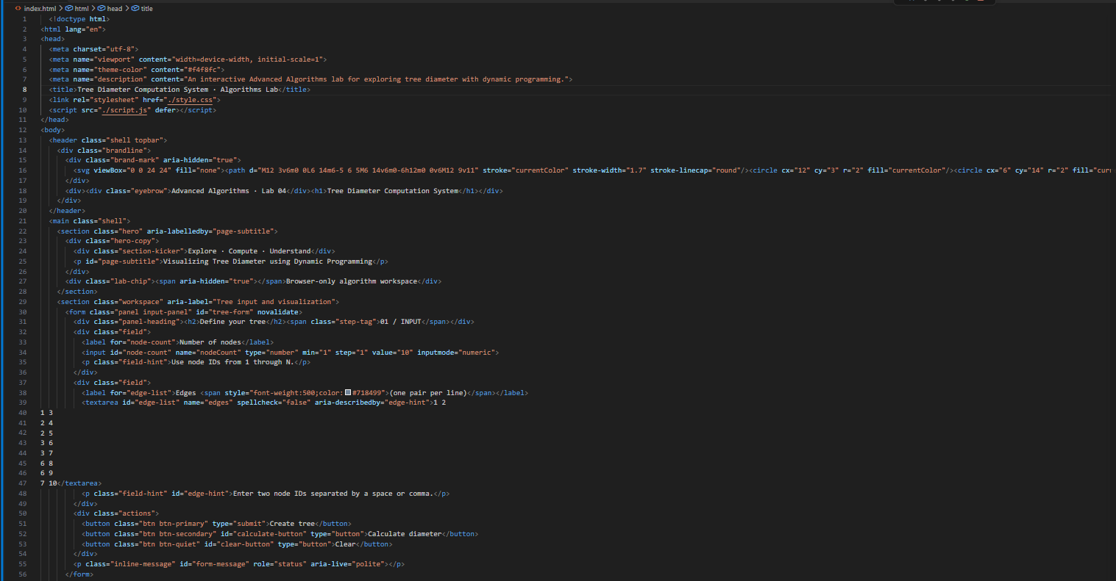
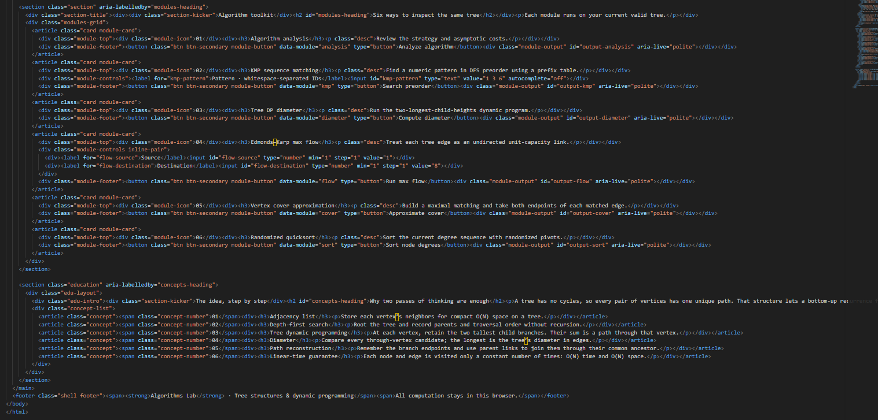
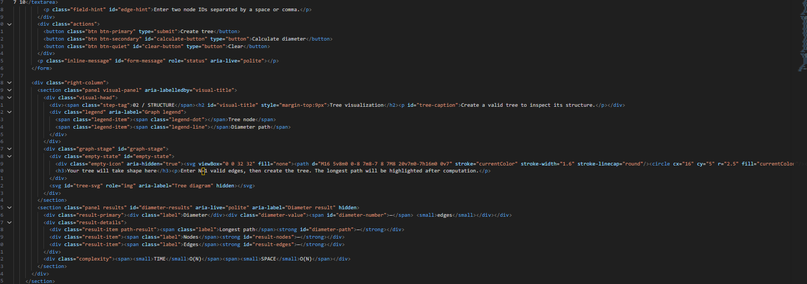
CODES

Slide 12
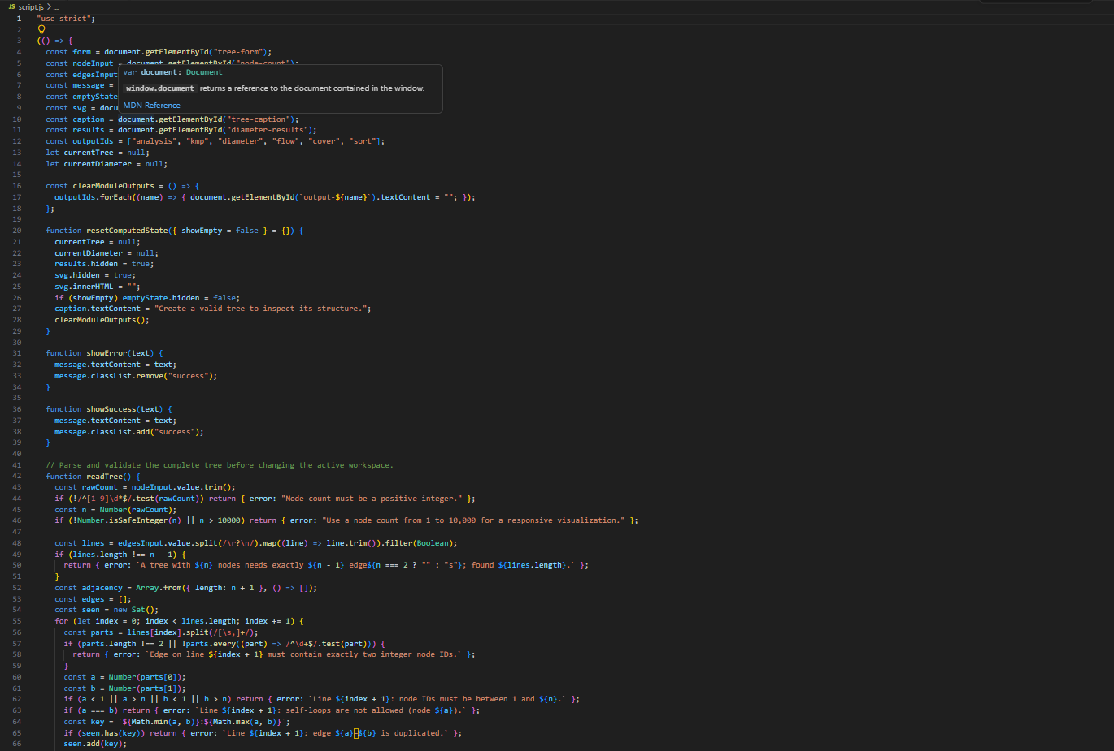
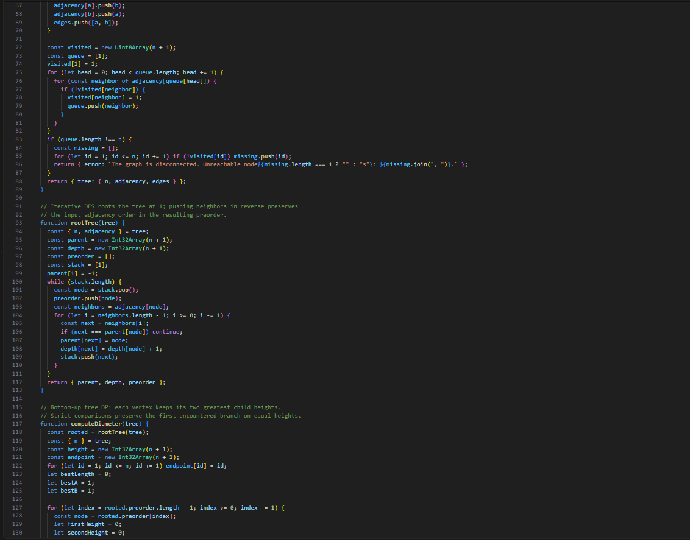
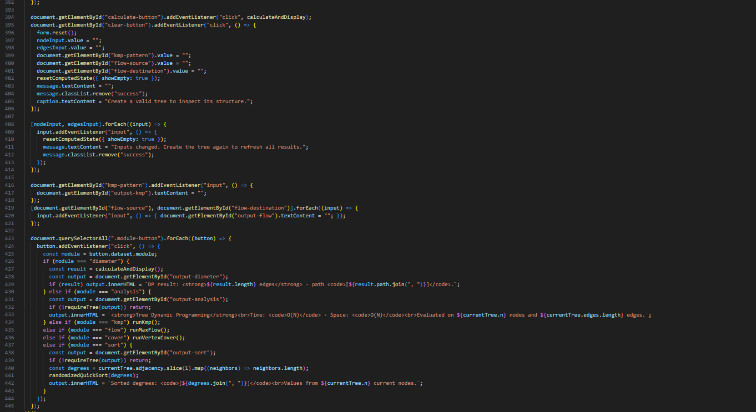
CODES

Slide 13
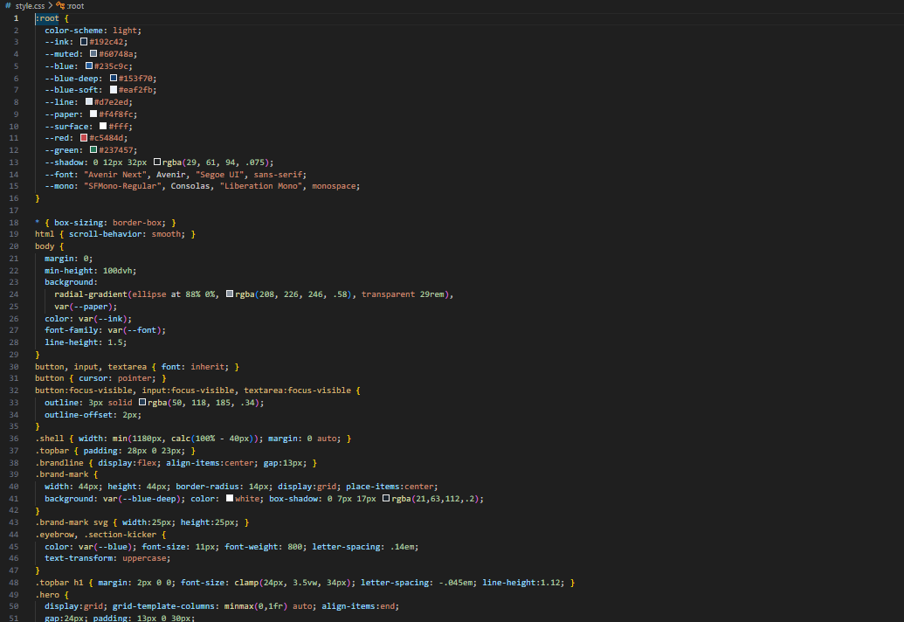
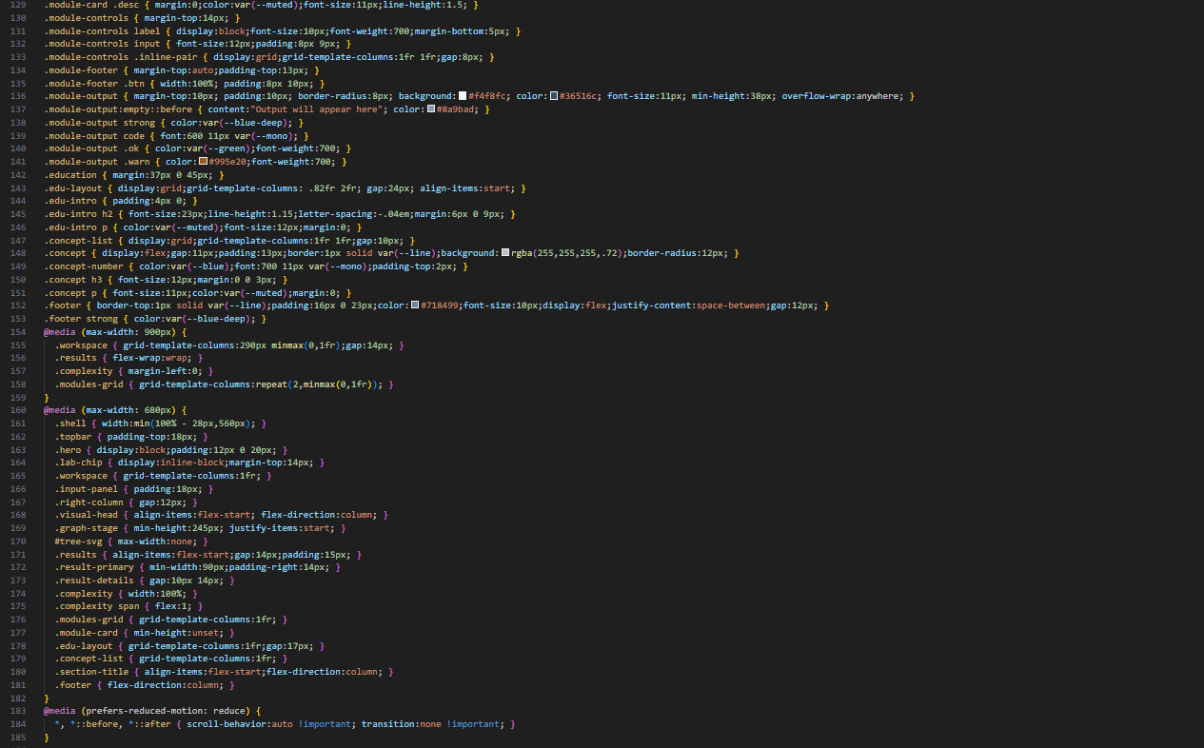

CODES

Slide 14
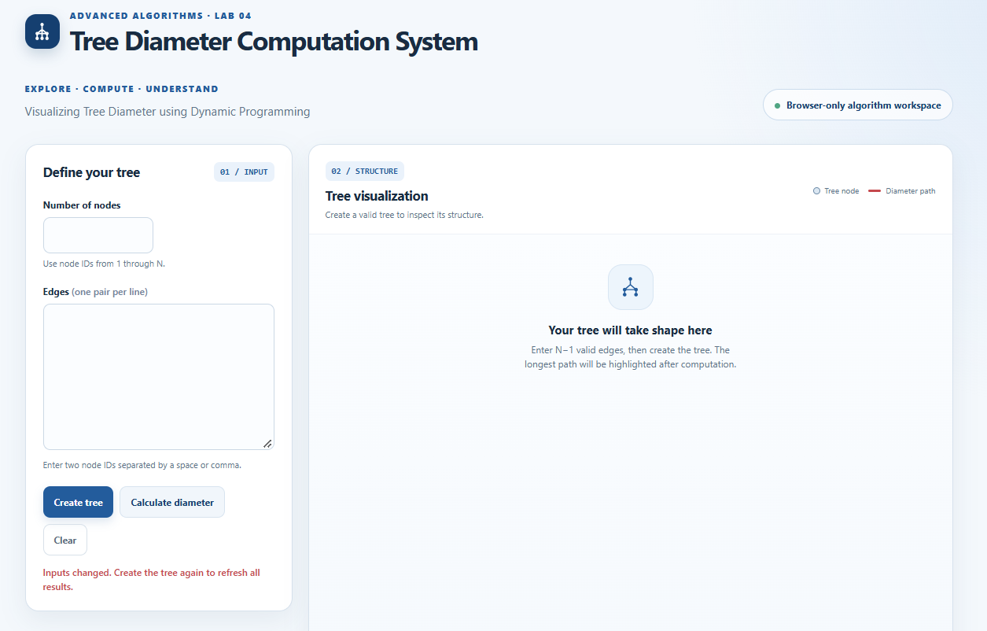
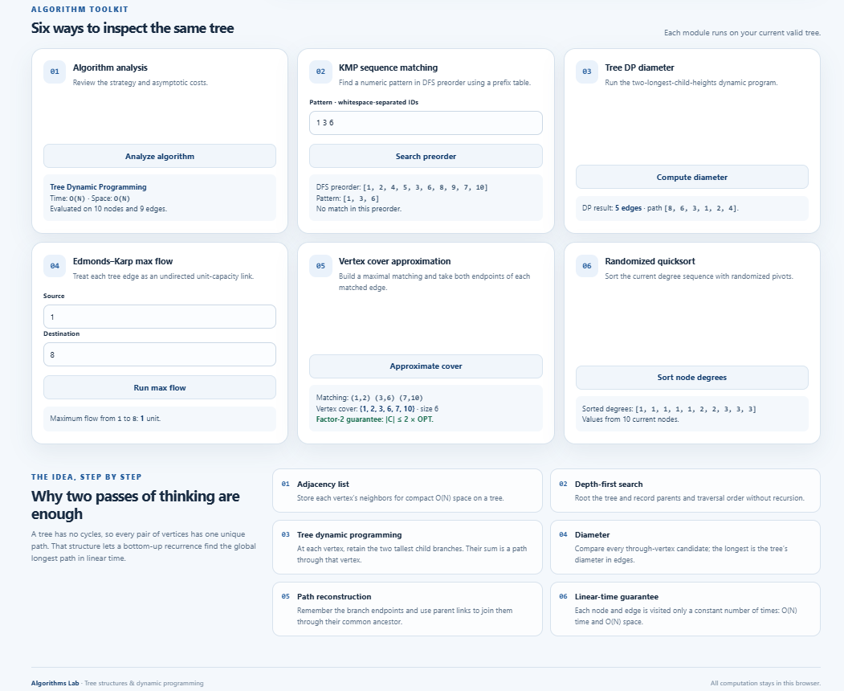
OUTPUT

Slide 15
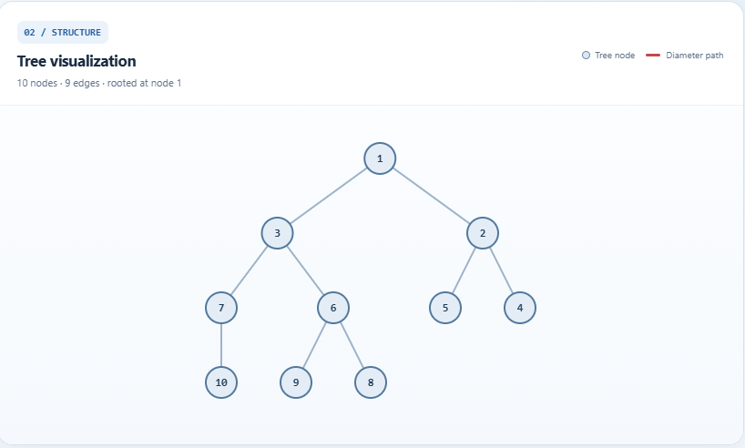
OUTPUT

Slide 16
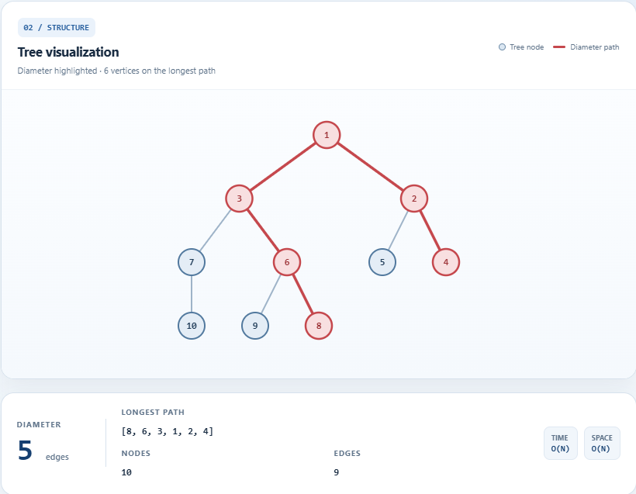
OUTPUT

Slide 17


GEO TAG PHOTOS

Slide 18


Slide 19
Thank you

